Slide 1


HOTEL AGGREGATOR ANALYSIS
USING POWER BI

Slide 2
Table of Contents
1. Problem Statement
2. Dataset Description
3. Project Objectives
4. Visualization
5. Conclusion
6. Recommendations

Slide 3
Problem Statement
This project aims to analyze a dataset of hotel aggregator listings using Power BI. The dataset comprises various attributes related to listings, hosts, reviews, and availability. The objective is to create comprehensive visualizations and insights that shed light on trends, patterns, and factors influencing the performance of listings. Through Power BI, we will explore key metrics such as pricing, availability, host characteristics, and review scores to derive actionable insights for improving the overall quality and competitiveness of the listings.

Slide 4
Dataset Description
id: Unique identifier for each listing.
listing_url: URL of the listing on the hotel aggregator platform.
scrape_id: Identifier for the data scraping event.
last_scraped: Date of the last data scrape.
source: Source of the listing information.
name: Name of the listing.
description: Description of the listing.
neighborhood_overview: Overview of the neighborhood where the listing is located.
picture_url: URL of the listing's picture.
host_id: Unique identifier for the host.
And many more columns capturing details about hosts, location, property type, room details, amenities, pricing, availability, reviews, and other relevant information

Slide 5
Project Objectives
1. Geographical Insights: Visualize the distribution of listings on a map to identify popular neighborhoods.
2. Pricing and Availability Analysis: Analyze pricing trends based on property types, room types, and accommodation capacity.
3. Host Performance: Evaluate host characteristics, including super host status, response times, and verification methods.
4. Review Scores and Guest Satisfaction: Examine review scores and their impact on overall listing performance.
5. Property Type and Room Analysis: Analyze the distribution of property types and room types.

Slide 6
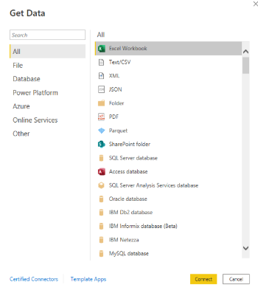
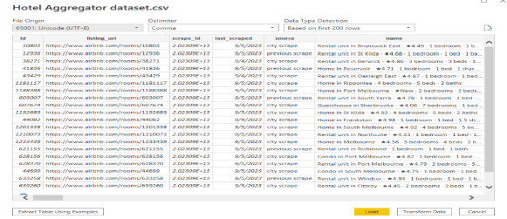
Visualization

Slide 7
Geographical Insights

Slide 8
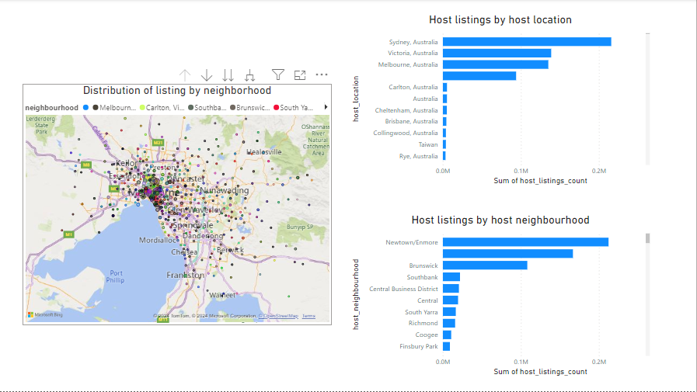

Slide 9
Pricing and Availability Analysis

Slide 10
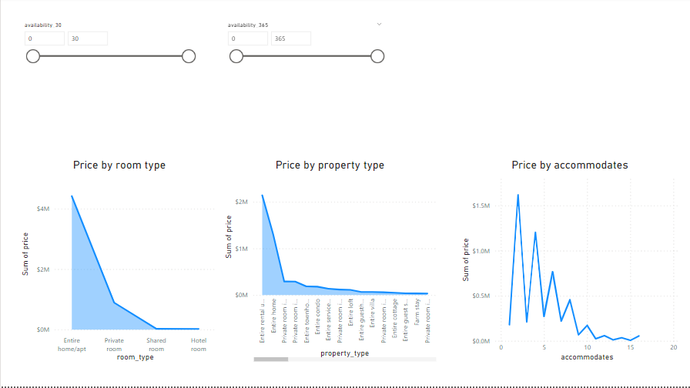

Slide 11
Host Performance

Slide 12
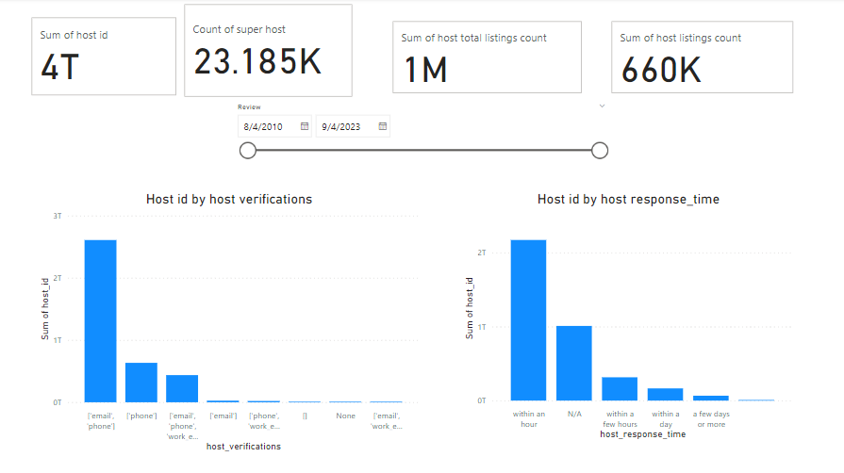

Slide 13
Review Scores and Guest Satisfaction

Slide 14
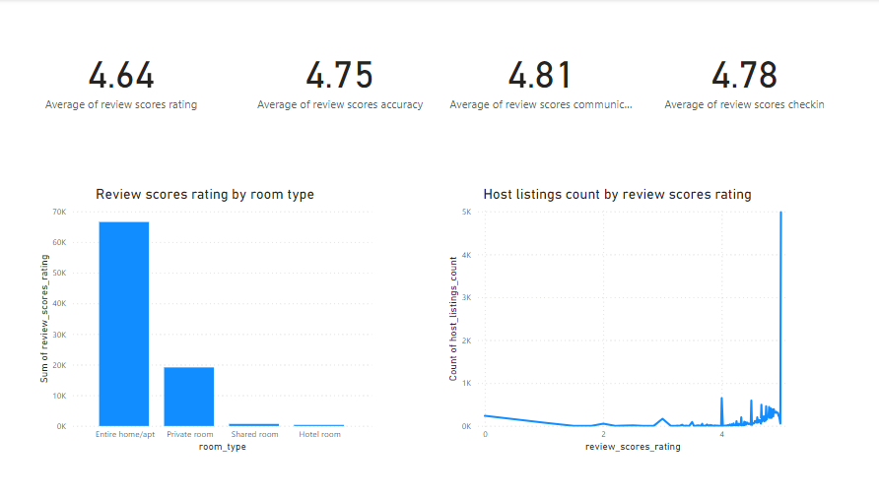

Slide 15
Property Type and Room Analysis

Slide 16
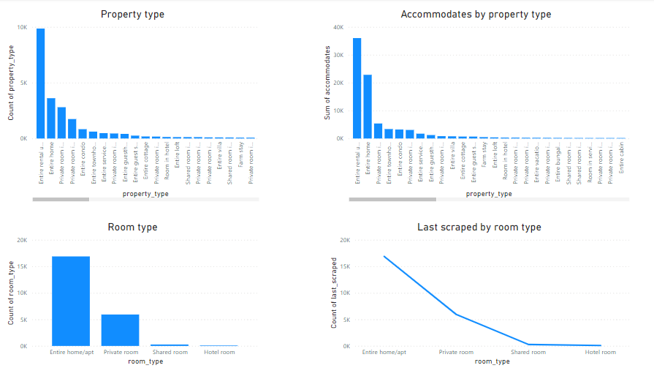

Slide 17
Conclusion
In conclusion, the geographical insights provided invaluable understanding into the distribution of listings across popular neighborhoods, host locations, and host neighborhoods. This knowledge sheds light on where properties are concentrated, where hosts are based, and which areas are favored by both hosts and guests. Additionally, the pricing and availability analysis offered insights into average prices for various property and room types, as well as accommodation capacities. Understanding host performance metrics such as response times and verification methods allows for a deeper comprehension of host behaviors and preferences. Furthermore, the correlation between review scores and various factors such as property and room types offers valuable insights into guest satisfaction levels and trends over time. Overall, these analytical insights enable informed decision-making and optimization strategies within the hospitality industry.

Slide 18
Recommendations
Emphasize the enhancement of review scores through the delivery of outstanding service and amenities.
Explore the advantages of attaining super host status for enhanced credibility.
The price does not increase in proportion to the capacity of accommodation.
Utilize pricing and availability insights to adjust rates based on demand, property type, and accommodation capacity. This dynamic pricing strategy can help maximize revenue while ensuring competitiveness
Encourage hosts to maintain prompt response times and utilize effective verification methods to enhance guest trust and satisfaction. Providing resources and incentives for hosts to improve these metrics can positively impact overall guest experiences

Slide 19
Thank You

